Slide 1
Collision Detection
Or why bullet hell games bog down

Slide 2
Things that are important to collision detection
Collision Physics
Broad Phase and Narrow Phase collision detections
Bounding volumes
Axis Aligned Bounding Boxes
Oriented Bounding Boxes
Space Partitioning
Sort and Sweep
Dynamic Bounding Volume Trees
Convex and Concave Shapes
Convex Hulls
Separate Axis Theorem
Gilbert-Johnson-Keerthi Algorithm
Support functions
Minkowski sum
simplicies
Expanding Polytope Algorithm
Inspired by: https://www.toptal.com/game/video-game-physics-part-ii-collision-detection-for-solid-objects

Slide 3


Time complexity
First of all if there are $n$ bodies in our simulation our time complexity becomes $O(n^{2}$) for pairwise comparison.
This means we want to minimize the amount of "did this hit that's" that we calculate.
Our first step is a broad view

Slide 4
The broad view
We want to eliminate anything that is not going to hit our target
Once we have eliminated those then we can start calculating the nitty gritty things

Slide 5
Top down approach
If we are worried about 3 dimensions, things are harder.
Clinkenbeard's lemma*: any collision calculation requires, at most, n-1 dimensions to check for a collision.
example
* I am pretty sure this is taken by someone else.

Slide 6
Top down approach
If we are worried about 3 dimensions, things are harder.
Clinkenbeard's lema: for any space calculating a gross collision requires analysis of, at most, n-1 vectors where n is the number of dimensions being considered.
example
Here we see 2b facing some slow moving orbs of death

Slide 7
Top down approach
If we are worried about 3 dimensions, things are harder.
Clinkenbeard's lema: for any space calculating a gross collision requires analysis of, at most, n-1 vectors where n is the number of dimensions being considered.
example
Here we see 2b facing some slow moving orbs of death

Slide 8
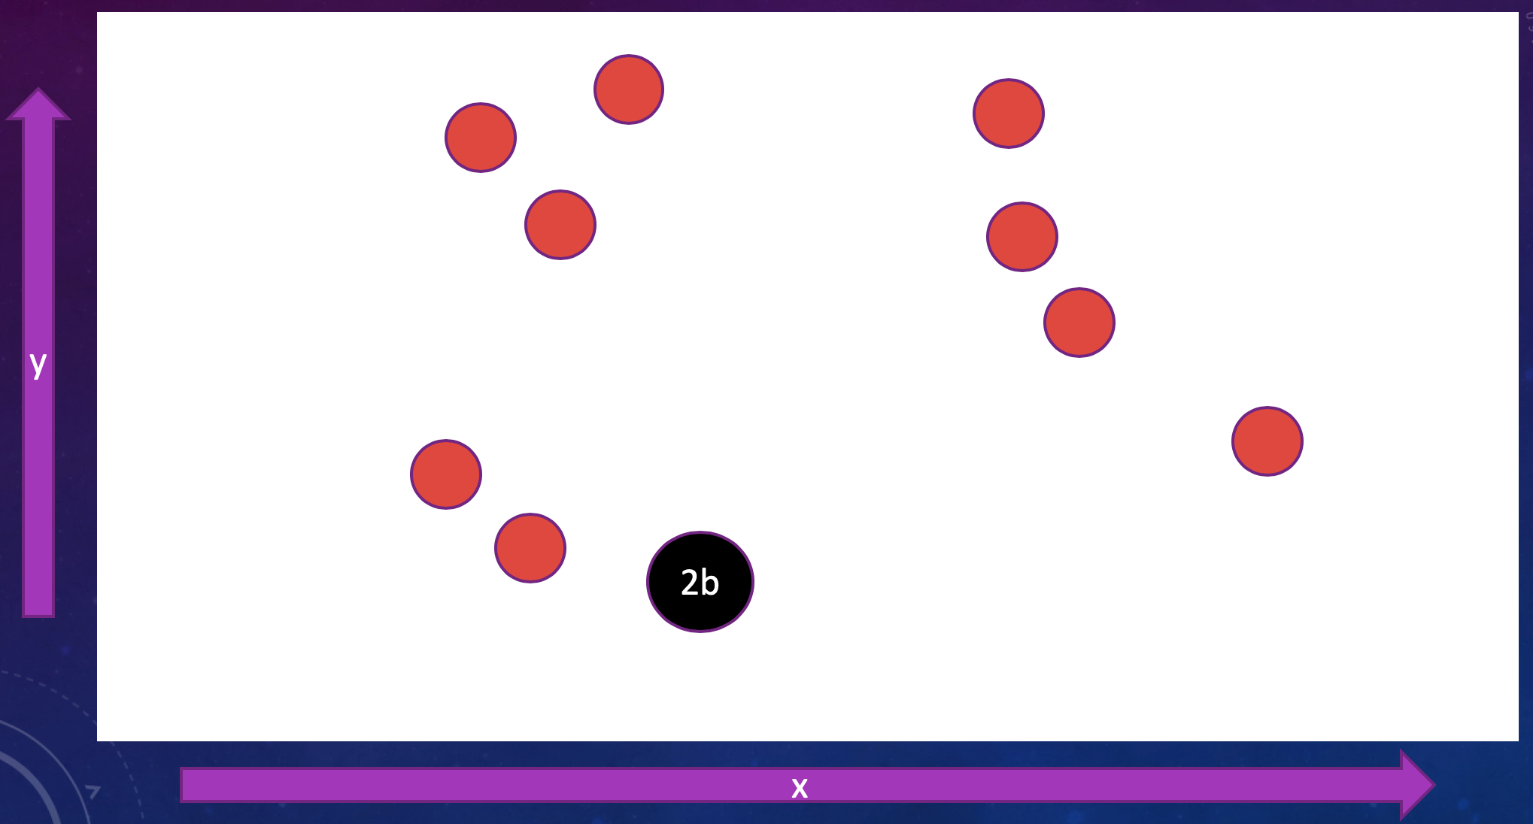
Top down approach
If we consider the scene in 2 dimensions
We can see that, unless there is a lot of movement in the x direction 2b is pretty safe
y
2b
x

Slide 9
Top down approach
If we consider the scene in 2 dimensions
We can see that, unless there is a lot of movement in the x direction 2b is pretty safe
Really all we need to do is draw lines from the center of each sphere along its main vectors and calculate if it is going to intersect any point of 2b

Slide 10
Top down approach
If we consider the scene in 2 dimensions
We can see that, unless there is a lot of movement in the x direction 2b is pretty safe
Really all we need to do is draw lines from the center of each sphere along its main vector and calculate if it is going to intersect any point of 2b

Slide 11
Top down approach
If we consider the scene in 2 dimensions
We can see that, unless there is a lot of movement in the x direction 2b is pretty safe
Really all we need to do is draw lines from the center of each sphere along its main vector and calculate if it is going to intersect any point of 2b

Slide 12

actually doing This is much harder
Especially if we have complex shapes.

Slide 13
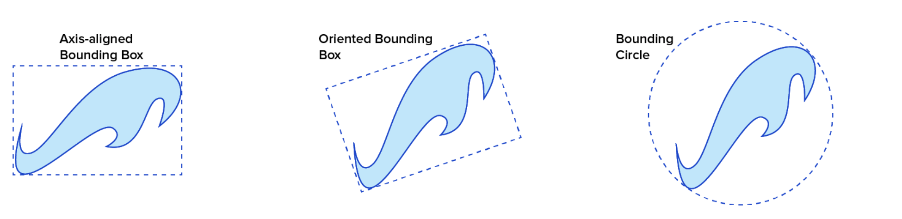
Bounding Volumes!
Essentially we draw a simpler shape around our complex shape and use that for our calculations

Slide 14
Differences
Axis Aligned bounding box (AABB) we draw a box around our shape with the axes aligned with X and Y (or X and Z or whatever). The box will have different dimensions but we always know the angles
y
x

Slide 15
Differences
Oriented Bounding box (OBB) we draw a box around our shape oriented to the shape. The box always has the same dimensions but the angle is random
y
x

Slide 16
Differences
Bounding Circle (BC) we draw a circle around our shape. The circle is going to be the same, less accurate, easier large scale calculations. This works well in 3D because a sphere is idempotent to rotation.
y
x

Slide 17
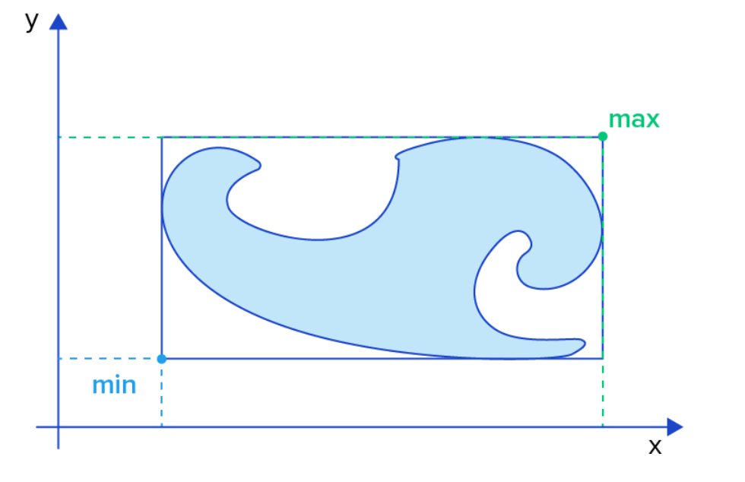
let us look at AABB
Axis Aligned Bounding Boxes are common, easy and okay for broad view collision detection (CD).
Testing for an overlap in AABBs is cheap and easy.
First lets assume a structure like this ➔

Slide 18
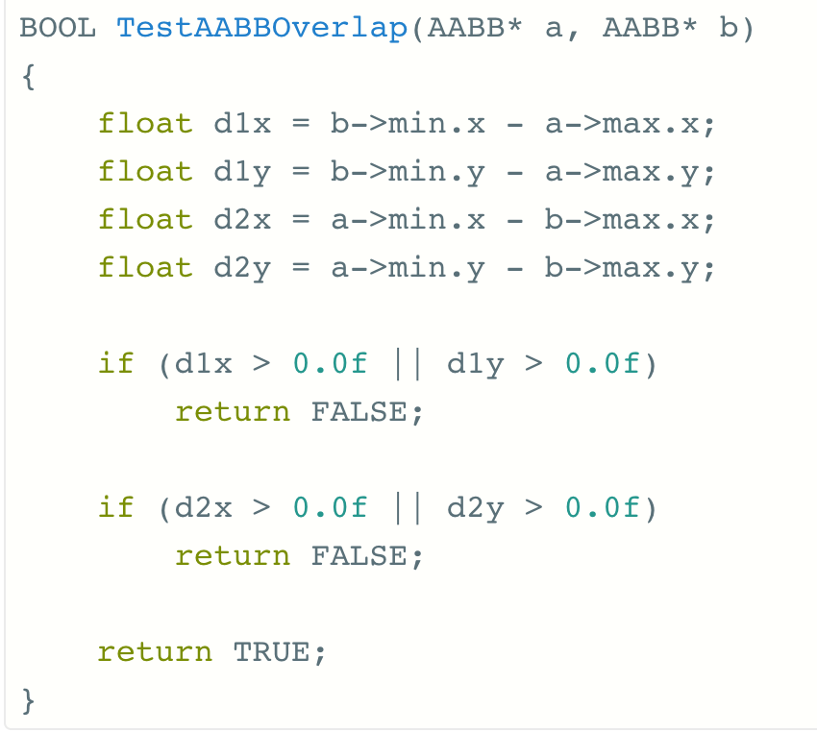
let us look at AABB
Then our code can test it like this

Slide 19
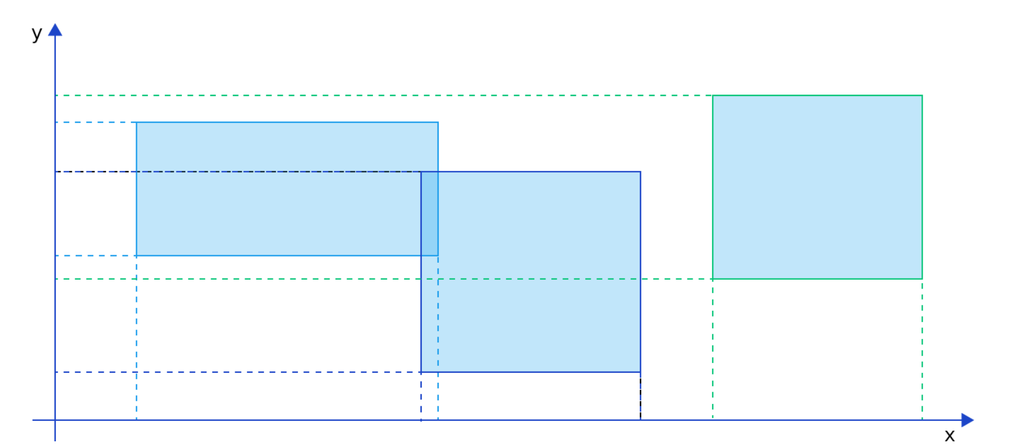
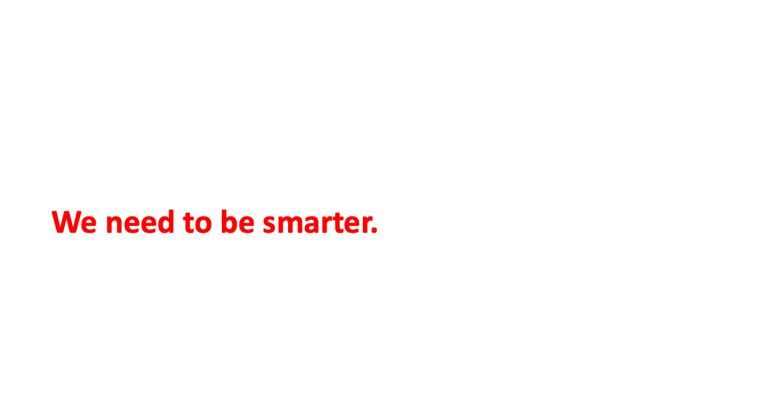
First let us look at AABB
Basically we are checking to see if any of our points overlap.
This is fine but we still have $O(n^{2}$) pairwise comparisons if we check everything.
We need to be smarter.

Slide 20
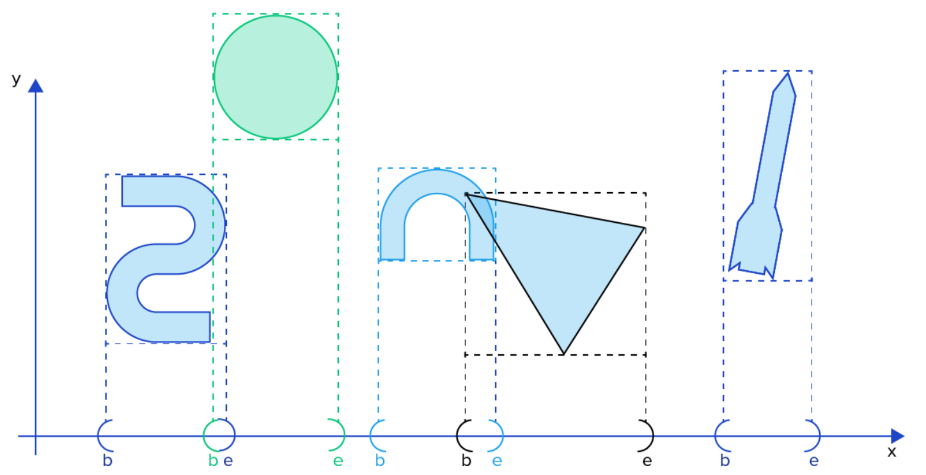

Sort and Sweep! AKA Sweep and Prune
This works well with AABBs
Basically every rigid body is an interval of beginning point to end point $\left[b,e\right]$
Add all of the b and e values to a list.

Slide 21

Sort and Sweet! AKA Sweep and Prune
Add all the b and e values to a list.
point | coord.
b1 | 2
e1 | 6
b2 | 5
e2 | 10
b3 | 13
e3 | 19
b4 | 17
e4 | 21
b5 | 25
e5 | 32
This works well with AABBs
Basically every rigid body is an interval of beginning point to end point $\left[b,e\right]$

Slide 22
Add all the b and e values to a list.
Sort it on coordinate.
point | coord.
b1 | 2
b2 | 5
e1 | 6
e2 | 10
b3 | 13
b4 | 17
e3 | 19
e4 | 21
b5 | 25
e5 | 32

Slide 23
Add all the b and e values to a list.
Sort it by coordinate.
Check the list for overlaps.
Some Axes may work better than others…
point | coord.
b1 | 2
b2 | 5
e1 | 6
e2 | 10
b3 | 13
b4 | 17
e3 | 19
e4 | 21
b5 | 25
e5 | 32

Slide 24
Sort and Sweep improvements
With proper sorting this could drastically reduce the number of pairwise comparisons
One implementation by Christer Ericson compares the coordinates per axis and picks the axis with the greatest variance, then quicksorts and compares the overlaps.

Slide 25
Spatial Segmentation
Another method for reducing the number of comparisons is known as a Dynamic Bounding Volume Tree or Dbvt
The basic idea is that each node of the tree is an AABB that contains all of its children

Slide 26
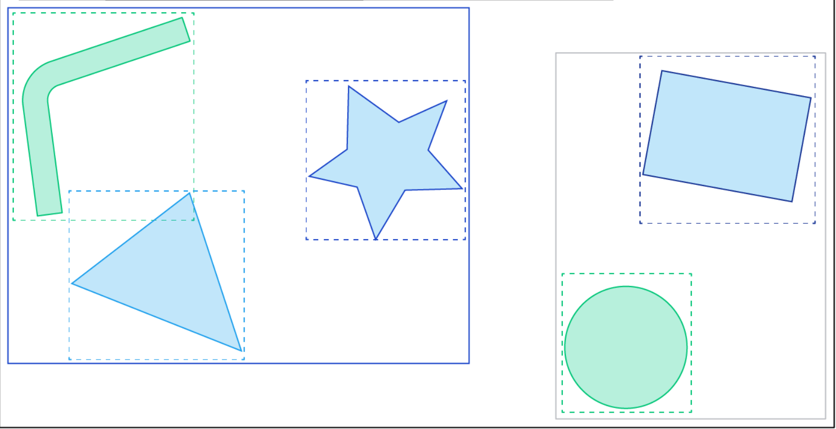
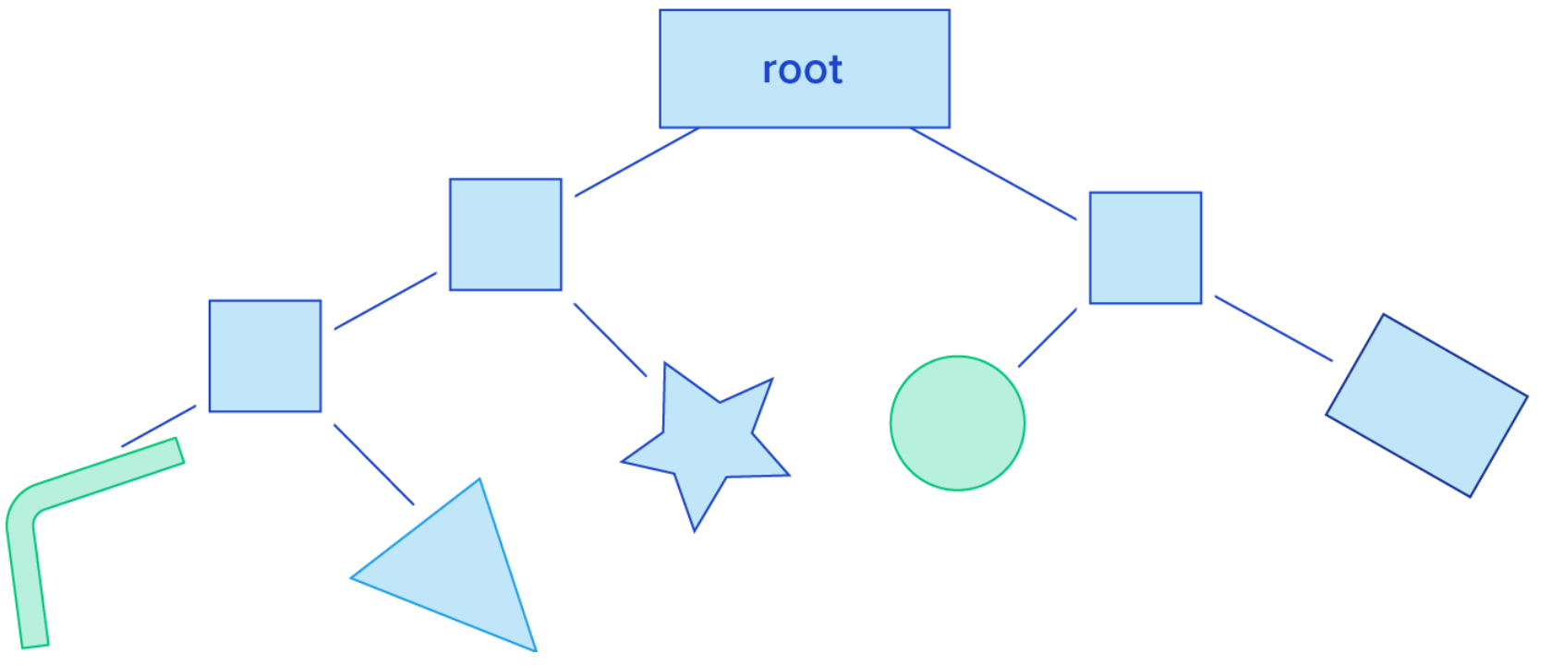
Spatial Segmentation
The basic idea is that each node of the tree is an AABB that contains all of its children

Slide 27
Broad and Narrow
In essence what we have been talking about are broad ways to check collision.
Essentially determining if there has been a collision. This is known as the Broad Phase
The next step is to refine the collision.
This is known as the Narrow Phase

Slide 28
Broad to Narrow
Once we have determined that some shapes MIGHT (or probably will) collide we have to determine if they actually do and what happens next.
Unfortunately for our calculations not everything is either a perfect sphere or square. It isn't even convex.

Slide 29
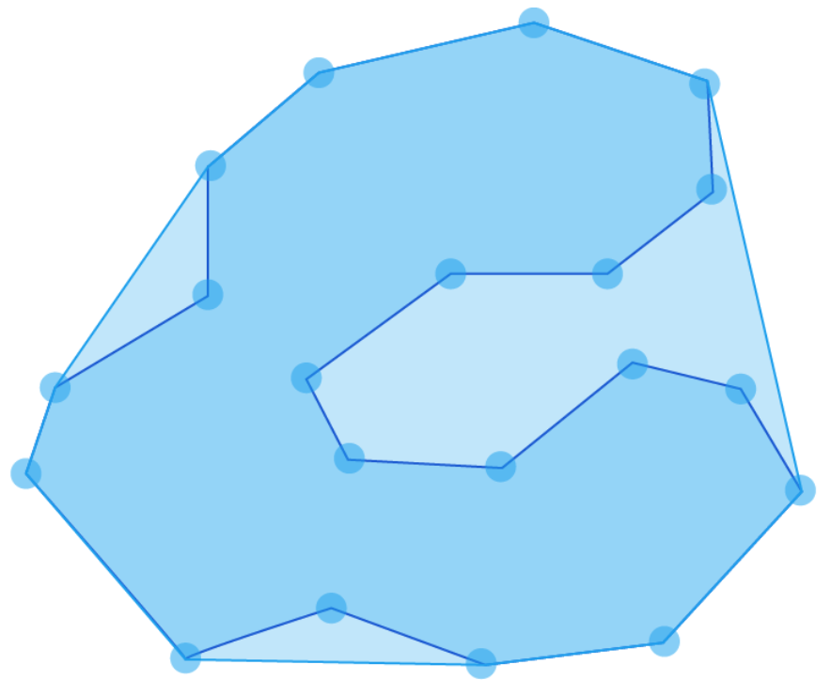
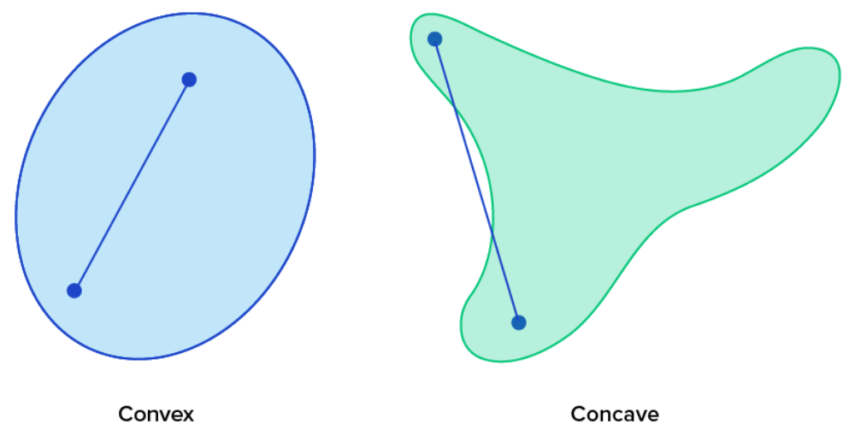
Convex vs Concave
Convex shapes are nice because from any one point to any other within the shape is a straight line.
Concave shapes suck because that isn't true.
Our solution is to wrap concave shapes in a hull. A convex hull.
This is essentially like putting a nail in each vertex and wrapping string around it
A good algorithm for this is one based on quicksort… it is named quickhull.
Concave hull

Slide 30
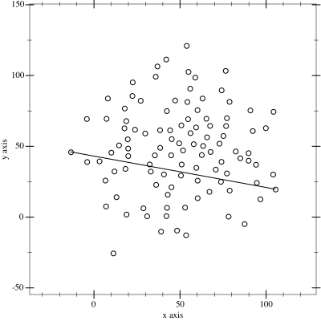

Quickhull
At time complexity $O(n\log{n)}$ quick hull is pretty quick. The steps are:
Find the points with min and max x coordinates, these will always be part of the convex hull.
Draw a line formed by the two points to divide the set in two subsets of points
Determine the point, on one side of the line, with the maximum distance from the line. The two points found before along with this one form a triangle.
The points inside the triangle cannot be part of the convex hull and are ignored in the next steps.
Repeat the previous two steps on the two new lines formed by the triangle.
Recurse until no points are left

Slide 31
The hull truth and nothing but hull truth.
The problem with a convex hull is that we lose detail. This leads to 'ghost collisions'
If we convex hull a bowl then fruit will appear to float on top of it.
One solution is to decompose our mesh into so called 'near convex' shapes.
The collisions will then be 'near enough'
One algorithm to do this is the V-HACD library

Slide 32
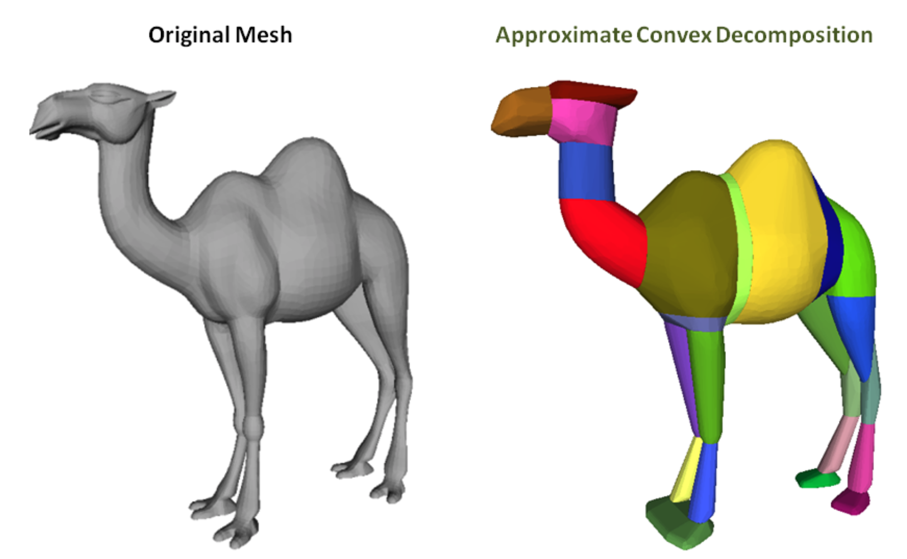
Example of V-HACD

Slide 33
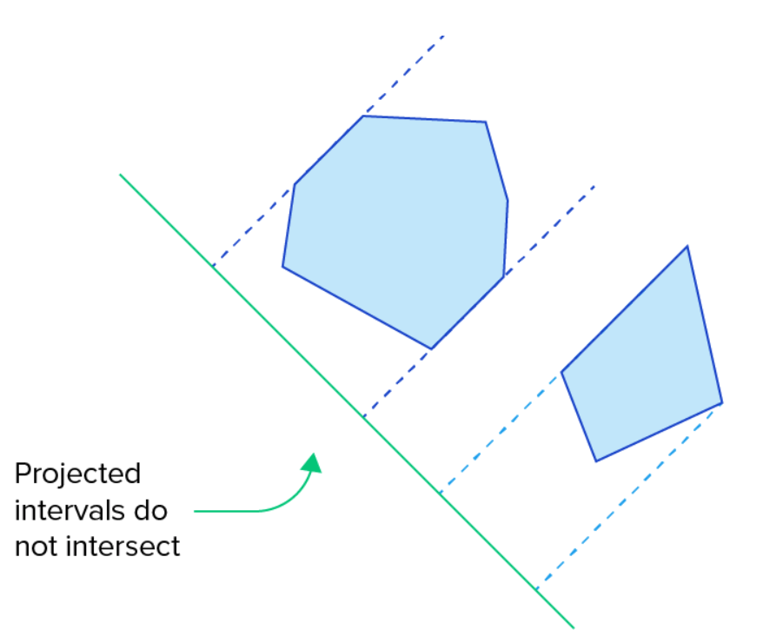
Separating Axis Theorem (SAT)
two convex shapes are not intersecting if and only if there exists at least one axis where the orthogonal projections of the shapes on this axis do not intersect.

Slide 34
Don't use SAT for spheres
With a sphere we only have to check if the distance between is greater than the sum of their radii from their centers.
With non-spheres it gets more complicated

Slide 35
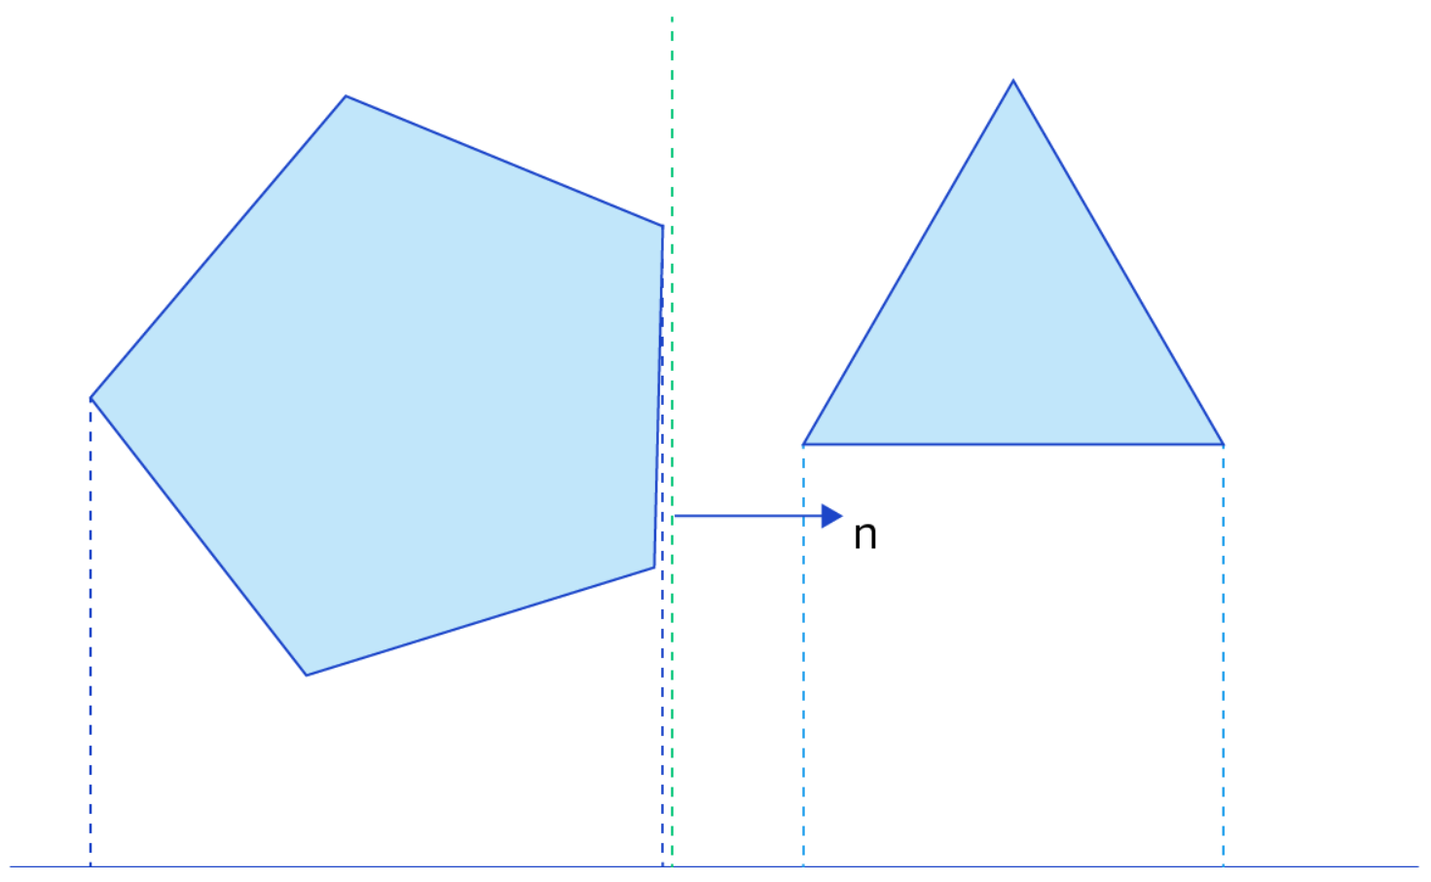
Norms, faces, and polygons
a
SAT basically checks if there is space in-between the shapes.
The trick is figuring out where to test for that.
If we take two vertices a and b, compute the normal vector n
b
The normal vector, n, is perpendicular to the edge and points away from the shape.

Slide 36
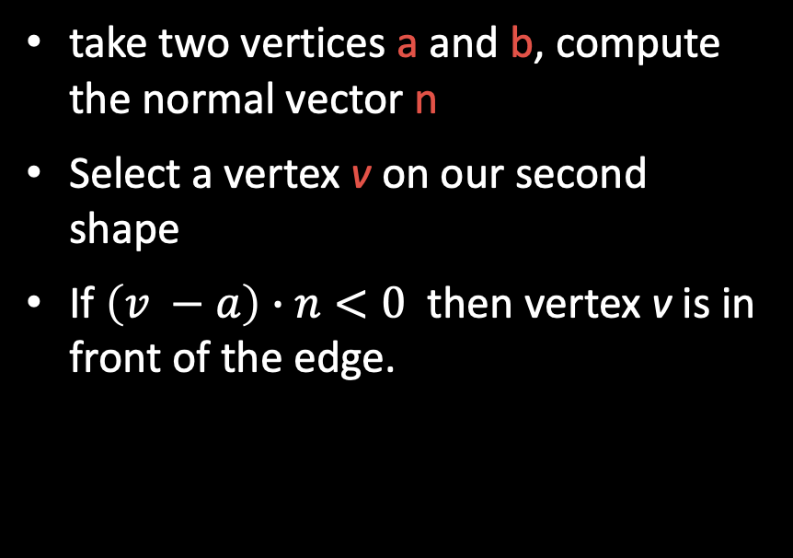
Norms, faces, and polygons
a
take two vertices a and b, compute the normal vector n
Select a vertex v on our second shape
If $\left(v −a\right)∙n<0$ then vertex v is in front of the edge.
b
The normal vector, n, is perpendicular to the edge and points away from the shape.

Slide 37
All together
For polyhedrons we use the normal vectors of the faces and the cross products of all edge combinations from each shape.
This is a lot of things to test.
Once we find a separating axis we can cache it and check it first next time.
If it no longer separates our shapes then we check on other things.

Slide 38
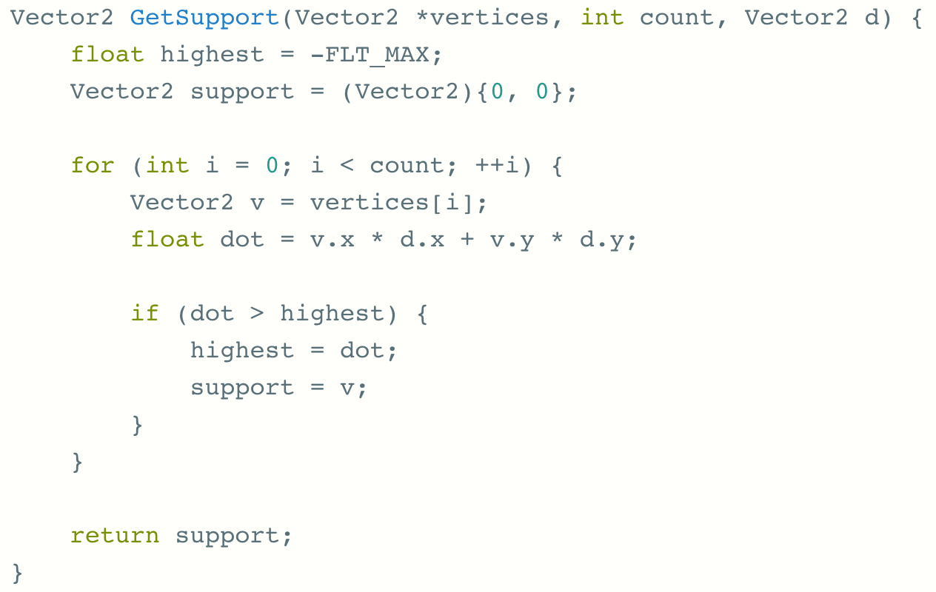
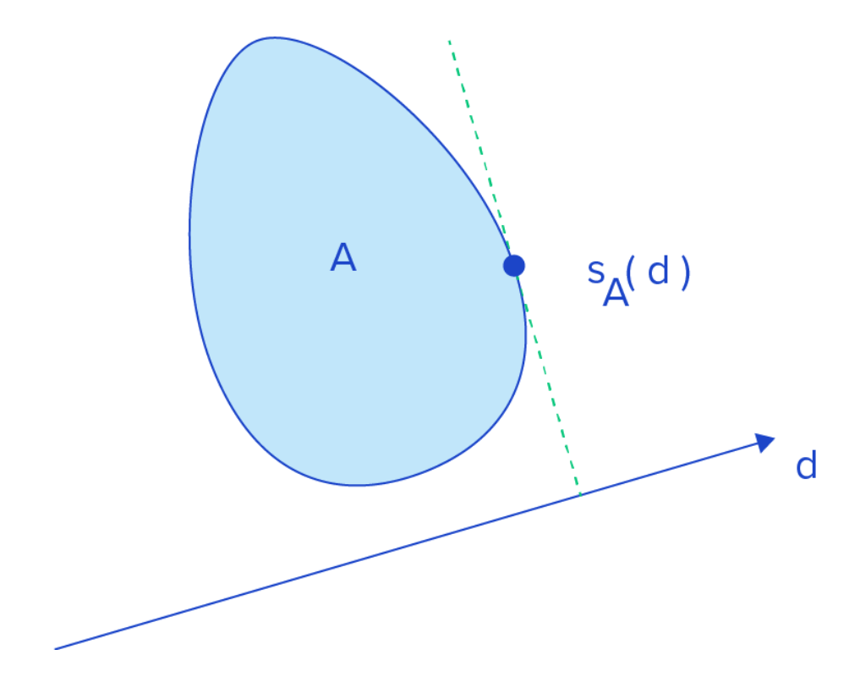
Support Functions.
If we want to find the point that is the furthest in a given direction, known as a support point, we simply take the dot product of each point and the vector we are interested in

Slide 39
SUPPORTING Gilbert-Johnson-Keerthi
There is an algorithm that is often used in collision detection called Gilbert-Johnson-Keerthi, or simply GJK
GJK uses the support function to generate simplices' and computes the Minkowski difference between them to iteratively determine collision states.
…
Hold on there cowboy.

Slide 40
Simplex defined
Basically triangles and tetrahedrons
Technically a shape that, for each new vertex adds a new face.
0 simplex is a point
1 simplex is a line
2 simplex is a triangle
3 simplex is a tetrahedron
A simplex is the smallest convex set containing the given vertices.

Slide 41
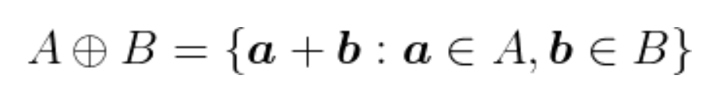
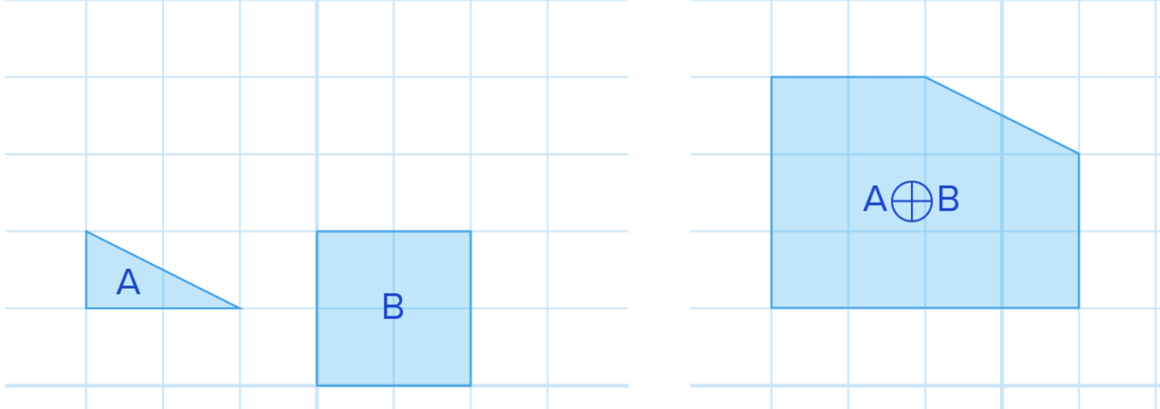
Minkowski sums
Add all the vertices together. Boom. Done.

Slide 42
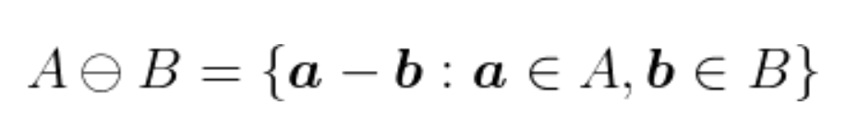
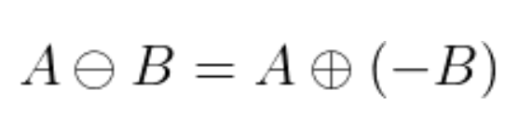
Minkowski Difference
If, instead of adding a and b, we add a and NOT b or
Which we can also write as

Slide 43
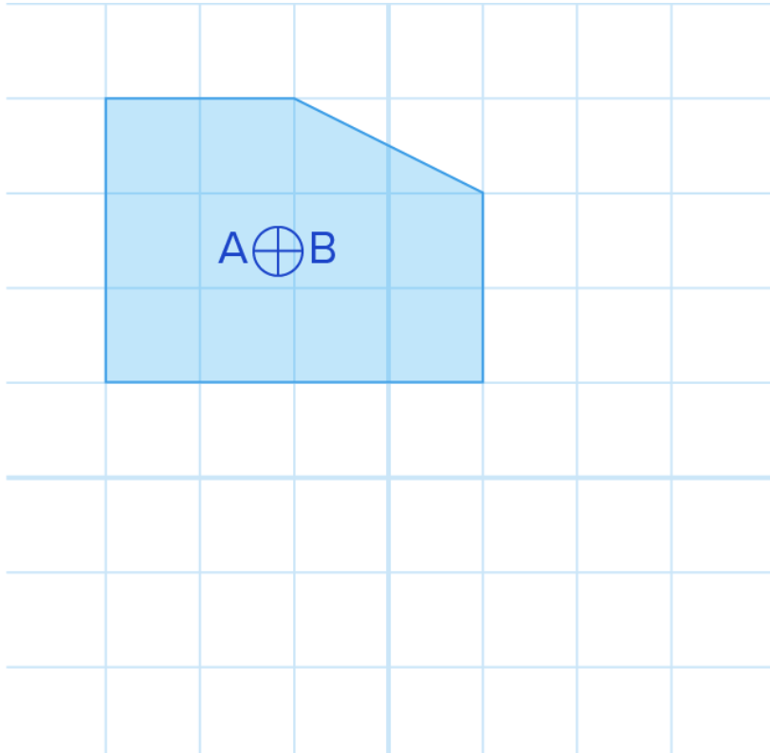
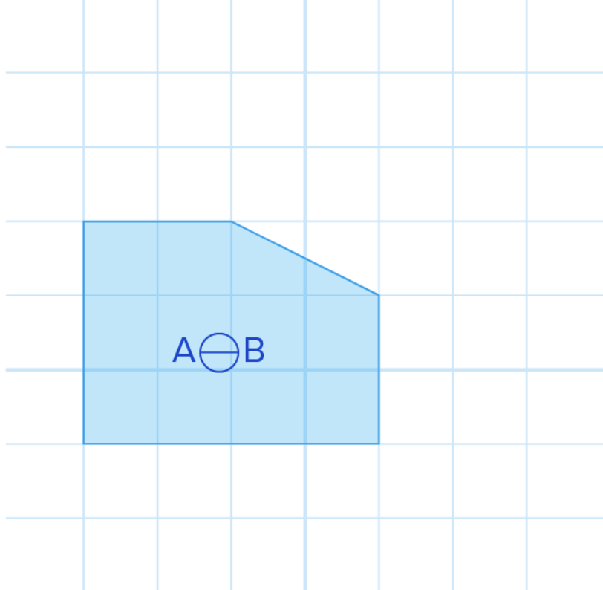
Minkowski Difference
Why would we do this?
Compare

Slide 44
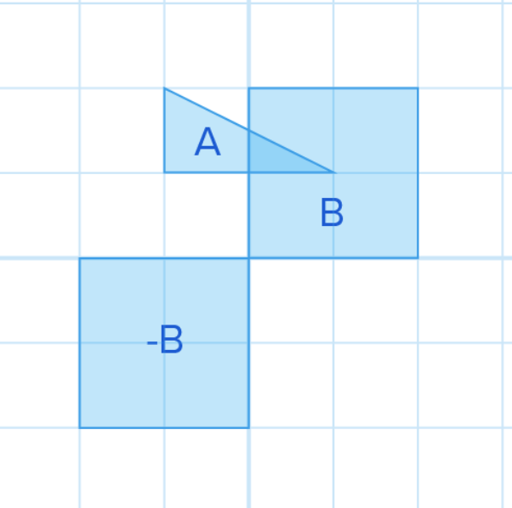
Minkowski Difference
The sum translates our shape.
The difference keeps our shape in the same relative position AND it contains the point of collision, if there is one.
If two shapes collide, they have at least one point in common.
Their difference is the zero vector. Also known as the origin.

Slide 45
Okay enough.
All of these are combined to find the point on one shape that is closest to the point on the other shape.
If a point is CONTAINED in the shape we are testing we know they collided.

Slide 46
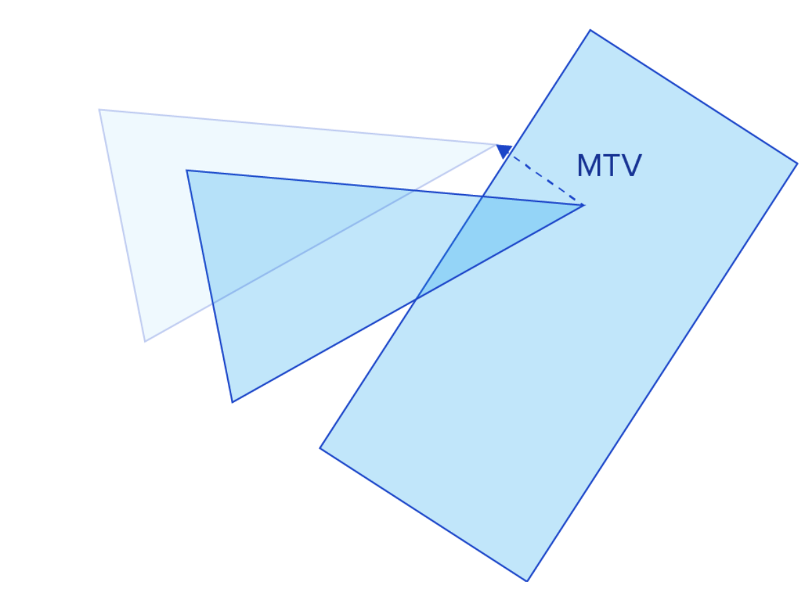
Minimum Translation Vector (MTV)
If two shapes have collided we can use the Minkowski Difference to find the furthest point of one shape inside the other
Then we calculate how far we have to translate the other shape to get it to the edge.

Slide 47
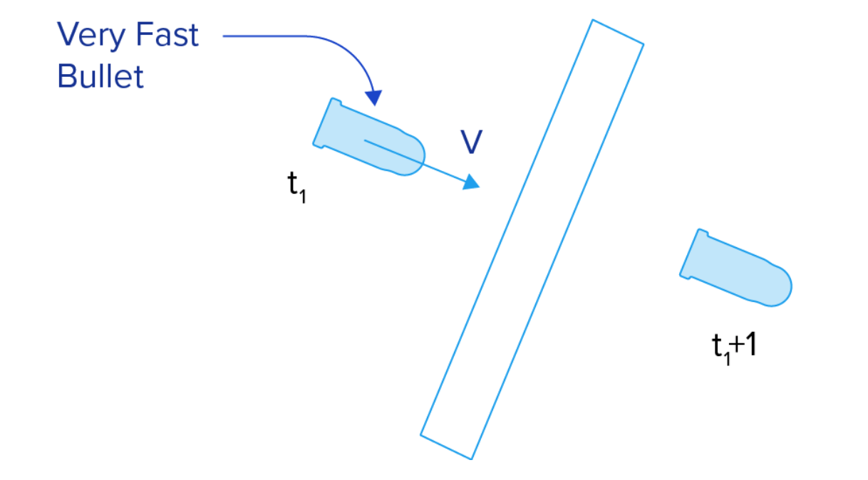
Last thing: Continuous and Discrete Collision Detection
Most of what we have seen is discrete collision detection (DCD).
Essentially each frame we test to see if there was a collision.
This can lead to some issues:

Slide 48
Continuous Collision Detection CCD
Calculate the vector and the velocity of our objects to determine when they collide.
For circles this is doable
Circles that are moving linearly.
For complex shapes this becomes a challenge as orientation matters
In the end we iterate and hope.

Slide 49
Sources
Https://www.toptal.com/game/video-game-physics-part-ii-collision-detection-for-solid-objects
http://gamma.cs.unc.edu/CULLIDE/
And about 300 Wikipedia articles and Youtube videos.

